Slide 1









Time-Series Data in Critical path analysis for project management
Presenters
KAZI MARUF AHMAD ALIF (19-40044-1)
ARIFIN SABID (19-41513-3)
MD. FAHIM MONTASIR MOJUMDER (19-41630-3)
KAZI EMADUZZAMAN GELANI (19-41678-3)
Under supervision of:
SUPTA RICHARD PHILIP
Lecturer
Faculty of Science & Technology
American International University - Bangladesh

Slide 2
Table of contents
01
02
03
04
05
Introduction
Literature Review
Methods
Results
Discussion & Conclusion

Slide 3


01
Introduction

Slide 4


Introduction
General Aims
Refining project planning for software project management
Specific Objectives
This study utilizes Critical Path Method networks to improve software project management to enhance forecasting accuracy and project efficiency.

Slide 5


Introduction
Research Question
This study explores how integrating Time-Series Data Analysis into Critical Path Analysis enhances forecasting accuracy and impacts project scheduling in software project management.
Overview
This thesis focuses on managing time-sensitive dependencies in software projects through the critical path method, aiming to develop a framework integrating time-series data analysis.

Slide 6

Introduction
Improving Project Forecasting Accuracy
Integrating time-series data into critical path analysis enhances forecasting accuracy in project management
JANUARY
FEBRUARY
MARCH
APRIL
MAY
JUNE
PHASE 1
Task 1
Task 2
PHASE 2
Task 1
Task 2

Slide 7
Table of contents
01
02
03
04
05
Introduction
Literature Review
Methods
Results
Discussion & Conclusion

Slide 8

02
Literature Review

Slide 9
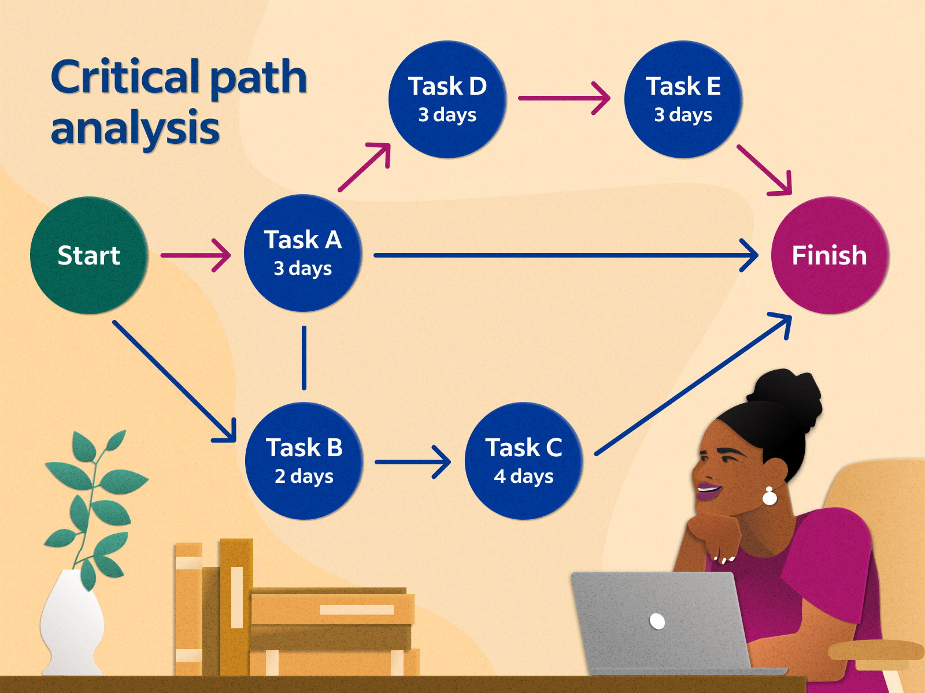
Literature Review
This extensive literature review explores the integration of time-series data analysis with Critical Path Analysis in software project management, emphasizing time-driven approaches, critical path analysis, and temporal interdependencies, with a focus on practical applications, challenges, and adaptability for improved project forecasting accuracy.

Slide 10
Table of contents
01
02
03
04
05
Introduction
Literature Review
Methods
Results
Discussion & Conclusion

Slide 11

03
Methods

Slide 12
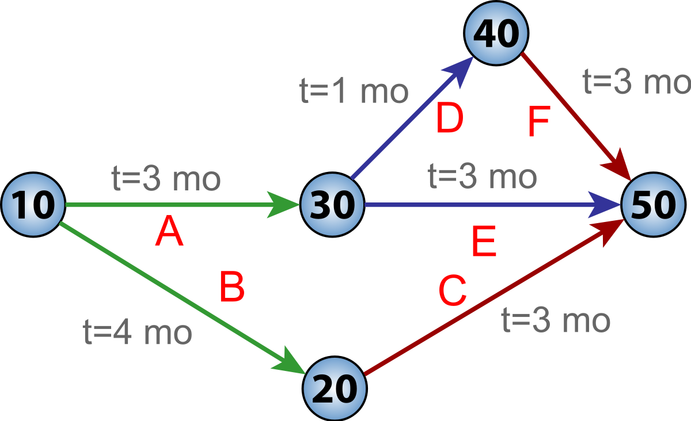
Methods
Critical Path Method Approach

Slide 13
Integrating Critical Path Method (CPM) in Project Management
Get the first task and duration
Get n-th task
Get duration for n-th task
Get predecessors for the n-th task
Analyze the tasks and create path
Output a diagram of all the paths and show the most optimized path for the project

Slide 14
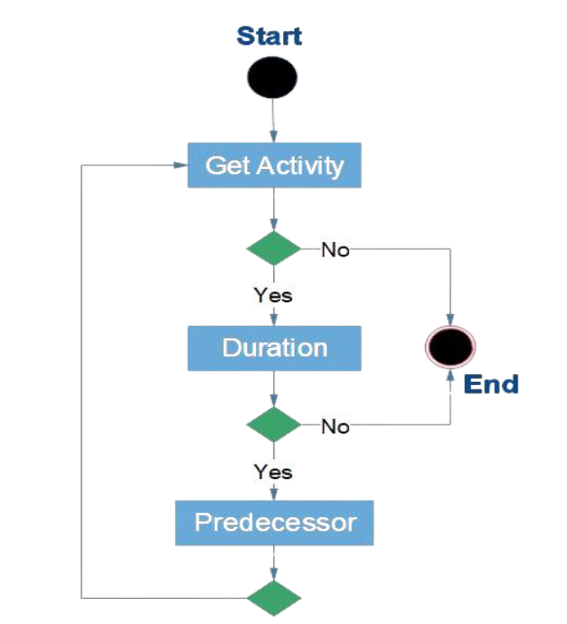
Methods
Algorithm
NetworkX’s topological sort

Slide 15
Methods
Early Start(ES)
Early Finish(EF)
Start
Destination
5
Start
Destination
0
5
5
Latest Start (LS)
Latest Finish(LF)
5
5
Start
Destination
Start
Destination
5
5

Slide 16
Table of contents
01
02
03
04
05
Introduction
Literature Review
Methods
Results
Discussion & Conclusion

Slide 17
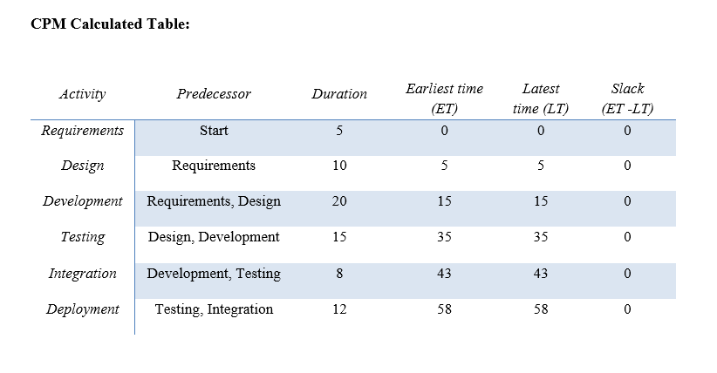
Results
Sample data set

Slide 18
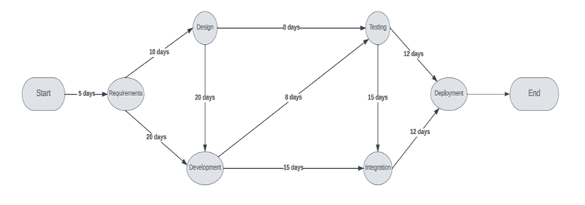
Results
All possible paths

Slide 19
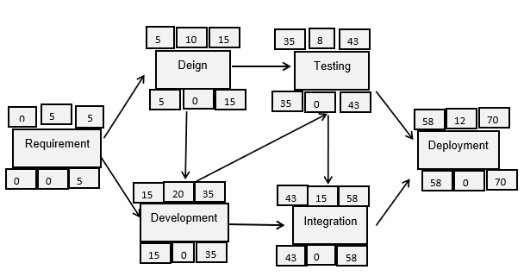
Results
Critical path calculations

Slide 20
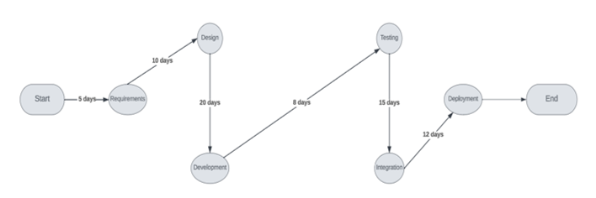
Results
Critical Path
Total days = 226

Slide 21
Table of contents
01
02
03
04
05
Introduction
Literature Review
Methods
Results
Discussion & Conclusion

Slide 22
Discussion & Conclusion
Our target audience
How it will impact the market
Empowering Project Managers
Addressing a Key Challenge
Optimizing Paths for Success
Marketwide Efficiency Boost
Collective Improvement in Project Delivery
Strategic Contribution to Business Success
Future possibilities
Lackings
Artificial Intelligence Integration
Dynamic Adjustments Based on Real-Time Data
Adaptive Project Management Approach
Ongoing Refinement Needed
Consideration of Resource Constraints

Slide 23


Thank you

